Slide 1

Modeling III

Slide 2
Introduction
Instructions
Download Tutorial 12 Zip
Unzip Folder
Required Packages
Open .Rmd File and Knit
Within R, Run all Code Chunks for Parts 1,2, and 3 (This was Covered in Tutorial 11)
library(tidyverse)
library(modelr)
library(xtable)

Slide 3
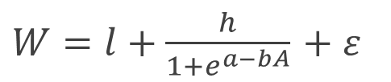
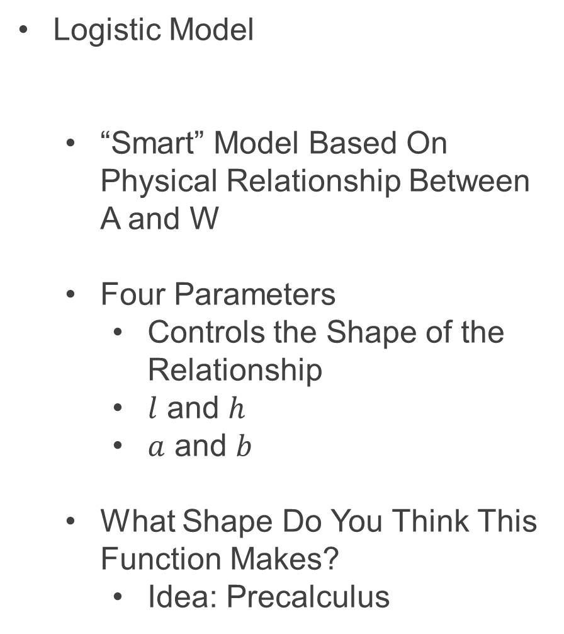
Part 4: Logistic Model
Logistic Model
“Smart” Model Based On Physical Relationship Between A and W
Four Parameters
Controls the Shape of the Relationship
$l$ and $h$
$a$ and $b$
What Shape Do You Think This Function Makes?
Idea: Precalculus
$W=l+\frac{h}{1+e^{a−bA}}$ $+ ε$

Slide 4
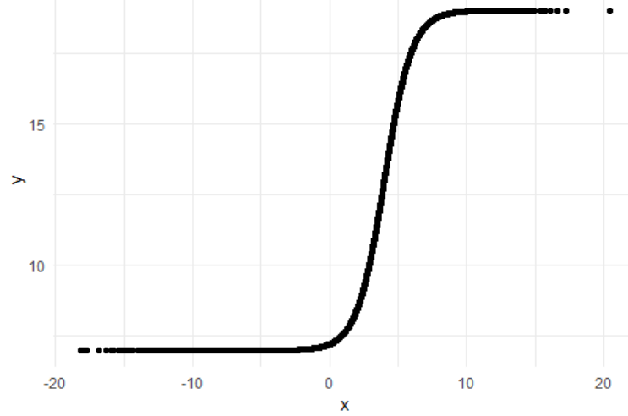
Part 4: Logistic Model
Run Chunk 1
Plant that Seed
Example Model
Parameter Investigation
What Does 7 Represent?
What Does 12 Represent?
What Does 4 Represent?
What Does 1 Represent?

Slide 5
Part 4: Logistic Model
Run Chunk 2
Creation of Modeling Function
Creation of MSE Function Specific to this Model
Run Chunk 3
Use optim() Function With Smart Starting Values Based on Understanding of The Model
Finds Estimates Based on Minimization of MSE

Slide 6
Part 4: Logistic Model
Run Chunk 4
Use Logistic Model Function and Estimated Parameters from optim() to Obtain
Predictions
Residuals

Slide 7
Intermission
Run Code Chunk
save.image() = Used to Save Workspace into .Rdata File
load() = Used to Load Workspace from .Rdata File
.Rdata = File Extension of R Workspace File (All Objects in Global Environment)

Slide 8
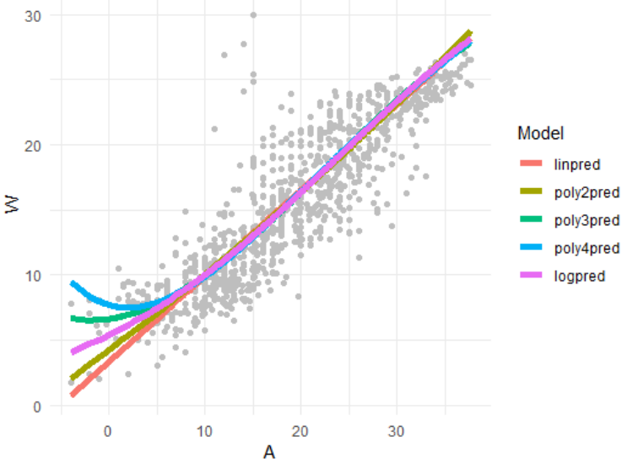
Part 5: Evaluation by Visualization
Run Chunk 1
Plots of Different Models
What Can We Say About the Different Models?
Which Model Would You Use?

Slide 9
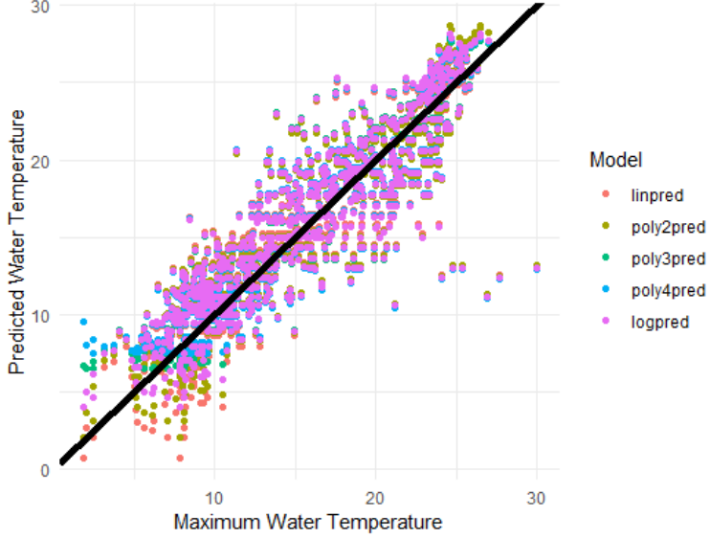
Part 5: Evaluation by Visualization
Run Chunk 2
Comparing Predictions vs Actual Maximum Water Temperatures
Models Give Similar Predictions

Slide 10
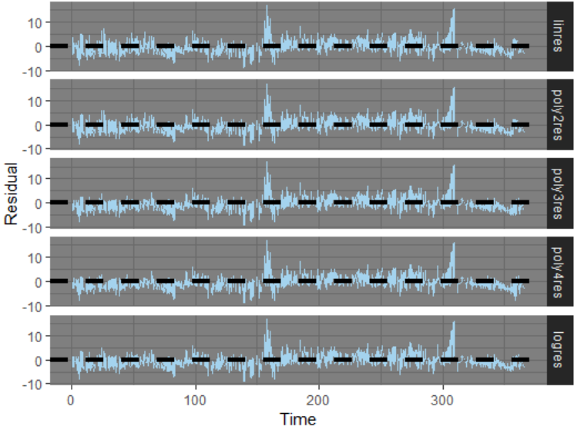
Part 5: Evaluation by Visualization
Run Chunk 3
Shows Residuals Under the 4 Models Plotted Over Time
What is the Problem?

Slide 11
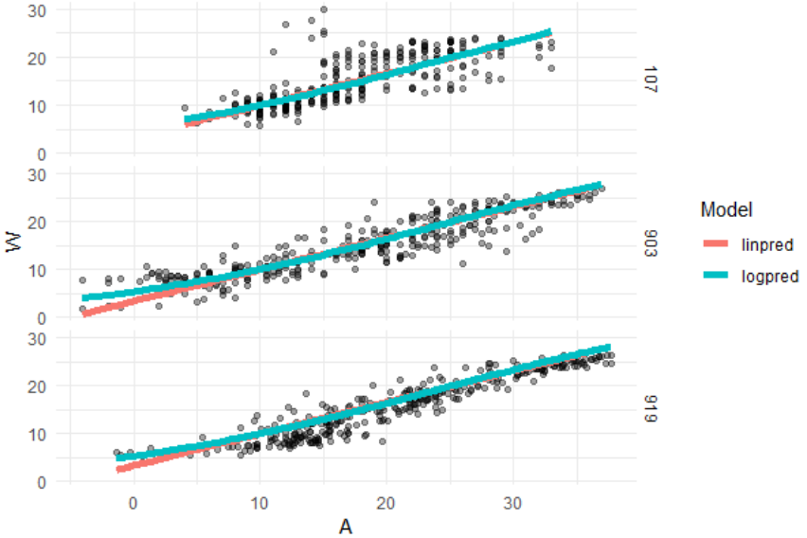
Part 5: Evaluation by Visualization
Run Chunk 4
Evaluate Models For the Three Locations Separately

Slide 12
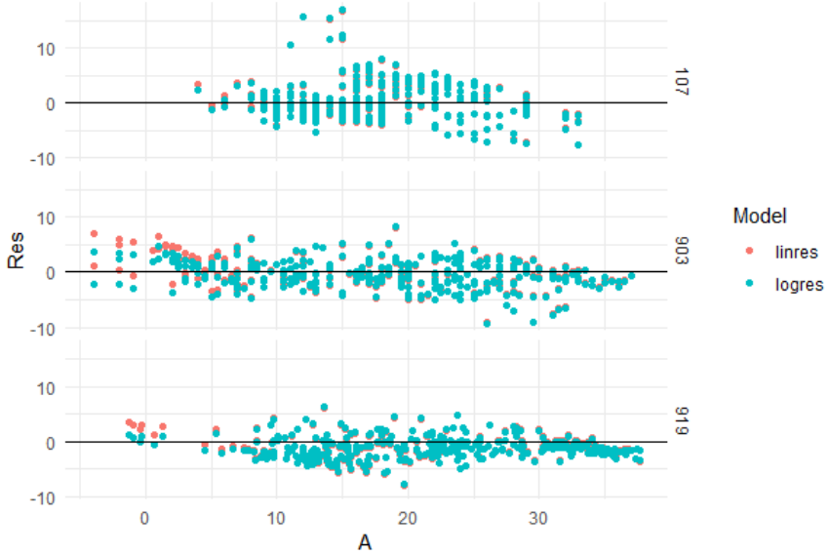
Part 5: Evaluation by Visualization
Run Chunk 5
Evaluate Error For the Three Locations Separately (by A)

Slide 13
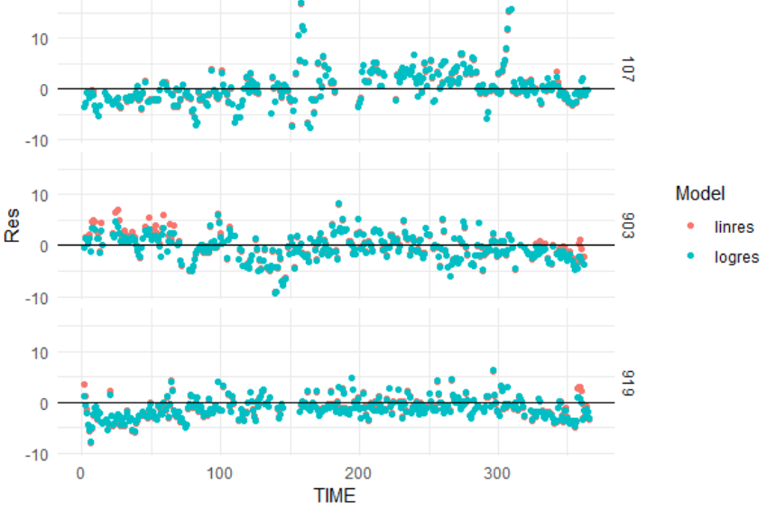
Part 5: Evaluation by Visualization
Run Chunk 6
Evaluate Error For the Three Locations Separately (by Time)

Slide 14
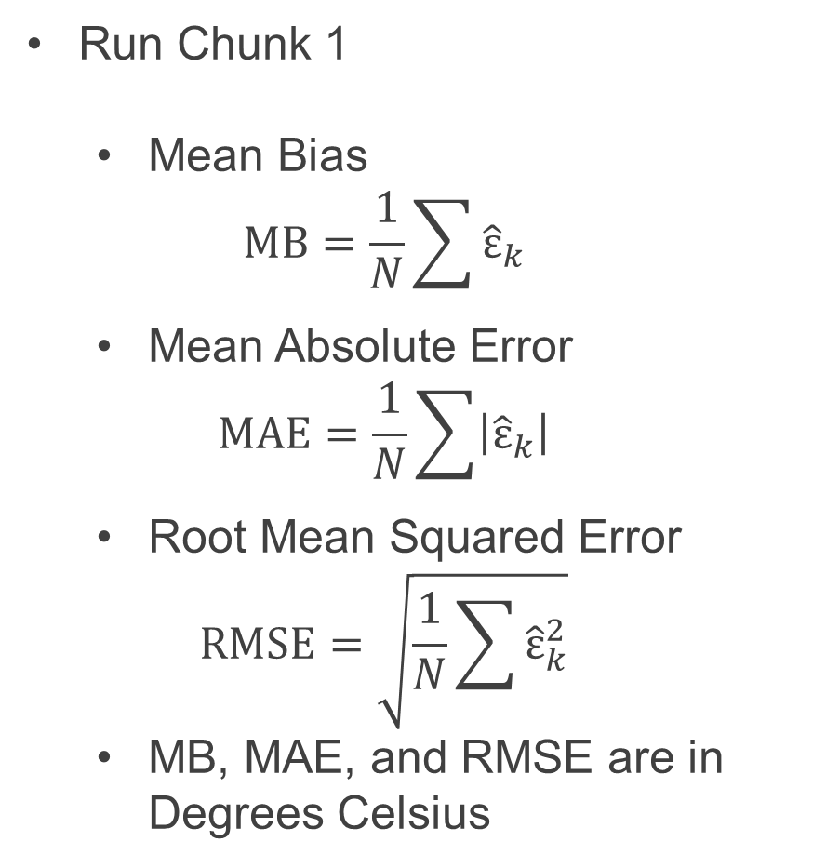
Part 6: Evaluation by Numerical Summary
Run Chunk 1
Mean Bias
$$MB=\frac{1}{N}\sum{{\hat{ε}}_{k}}$$
Mean Absolute Error
$$MAE=\frac{1}{N}\sum{\left|{\hat{ε}}_{k}\right|}$$
Root Mean Squared Error
$$RMSE=\sqrt{\frac{1}{N}\sum{{\hat{ε}}_{k}^{2}}}$$
MB, MAE, and RMSE are in Degrees Celsius

Slide 15
Part 6: Evaluation by Numerical Summary
Summarizing Table
Evaluate MB, MAE, and RMSE on Test Data to Choose Best Model Going Forward
Sketch of Table We Want
Before Writing Code, Have a Plan for the Output
Model | MB | MAE | RMSE
Linear
Poly(2)
Poly(3)
Poly(4)
Logistic

Slide 16
Part 6: Evaluation by Numerical Summary
Chunk 2
Run Line-By-Line
Think About Ways to Quickly Apply All 3 Functions to All Residuals
Run Chunk 3
Combine rename(), gather(), group_by(), and summarize()
Chunk 4
Change eval=F to eval=T and Knit the File (What is Seen?)

Slide 17
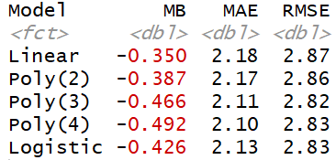
Part 6: Evaluation by Numerical Summary
My Results Based on My Seed
When Results Are This Close, Always Consider the Most Simple Model

Slide 18
Discussion
Problems With The Approach
Same Model For All Locations
Not All Locations Used in Train
Not All Locations Used in Test
Residuals Indicate that Model Can Be Improved
All Models Have the Same Issue if Used for Predicting the Maximum Water Temperature Given the Maximum Air Temperature

Slide 19
Closing
Disperse and Make Reasonable Decisions

